Slide 1
IMPLEMENTING WIRELESS ACCESS FOR MOBILE DEVICES
ENTERPRISE NETWORKING

Slide 2
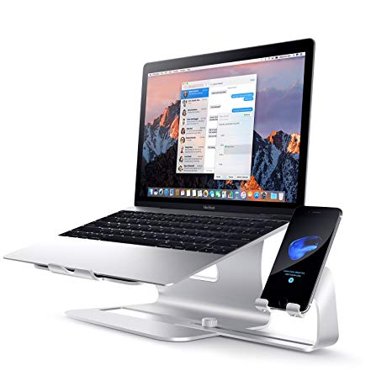
COMMON NETWORK DEVICES
DSL Modem
This converts digital signals into analogue signals that are suitable for sending over a telephone line. It is usually built into the Internet/broadband router and not normally purchased as a separate component.
ICS (Internet Connection Sharing)-
Internet connection sharing allows you to share an Internet connection with other computers on a Local/home Network.
It requires that one computer be designated as the sharing computer (the computer with the Internet connection).
Firewall
A firewall functions like a router except that it blocks traffic from the external network according to user configured rules.
Notes:
Some of the common network devices for both the house and enterprise include;
DSL Modem
This converts digital signals into analogue signals that are suitable for sending over a telephone line. It is usually built into the Internet/broadband router and not normally purchased as a separate component.
Firewall
A firewall functions like a router except that it blocks traffic from the external network according to user configured rules
ICS (Internet Connection Sharing)-
Internet connection sharing allows you to share an Internet connection with other computers on a Local/home Network.
It requires that one computer be designated as the sharing computer (the computer with the Internet connection).

Slide 3
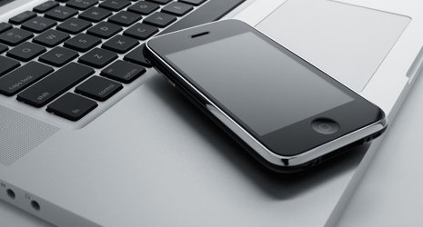
Network Hub
A hub connects two or more computers together (like switch in diagram above).
Hubs are effectively multi port repeaters and operate at the physical layer (level one). They do not examine the network traffic. They are being replaced today by the switches.
Network Bridge
A bridge connects two network segments together and is a selective repeater. It examines the MAC address of the traffic it sees and learns which network segments contain the various MAC address
Notes:
Network Hub
A hub connects two or more computers together (like switch in diagram above).
Hubs are effectively multi port repeaters and operate at the physical layer (level one). They do not examine the network traffic. They are being replaced today by the switches.
Network Bridge
A bridge connects two network segments together and is a selective repeater. It examines the MAC address of the traffic it sees and learns which network segments contain the various MAC address

Slide 4

Network Switch
A switch Connects two or more computers together and used today in preference to a hub or bridge.
Like a bridge a switch learns about MAC address connected to each port and will only send data on that port that is addressed to those MAC addresses.
Routers
A router connects networks together. Routers operate at the networking level of the TC protocol stack.
On Home networks the router is responsible for connecting the home network to the Internet and provides several important networking services like:
DHCP
DNS
Notes:
Routers
A router connects networks together. Routers operate at the networking level of the TC protocol stack.
On Home networks the router is responsible for connecting the home network to the Internet and provides several important networking services like:
DHCP
DNS
Network Switch
A switch Connects two or more computers together and used today in preference to a hub or bridge.
Like a bridge a switch learns about MAC address connected to each port and will only send data on that port that is addressed to those MAC addresses.

Slide 5

COMMON NETWORK DEVICES
Virtual private network (VPN) access
You can configure VPN access requirements on a mobile device. It is critical that all connections to your enterprise environment do so through a VPN, and setting the policies on behalf of the user makes it that much easier for the user to be in compliance with your policies.
Notes:
Virtual private network (VPN) access
You can configure VPN access requirements on a mobile device. It is critical that all connections to your enterprise environment do so through a VPN, and setting the policies on behalf of the user makes it that much easier for the user to be in compliance with your policies.

Slide 6

WIRELESS DEVICES AT HOME Vs BUSINESS
While many enterprise devices can be installed in a large home network, a few if any home network devices can fit into a large enterprise network.
Wireless network devices are implemented into a network based on the size of the network that the user intends
The cost of a deice is also considered relative to the size of the network it will serve.
Notes:
While many enterprise devices can be installed in a large home network, a few if any home network devices can fit into a large enterprise network.
The cost of a deice is also considered relative to the size of the network it will serve.
Wireless network devices are implemented into a network based on the size of the network that the user intends

Slide 7
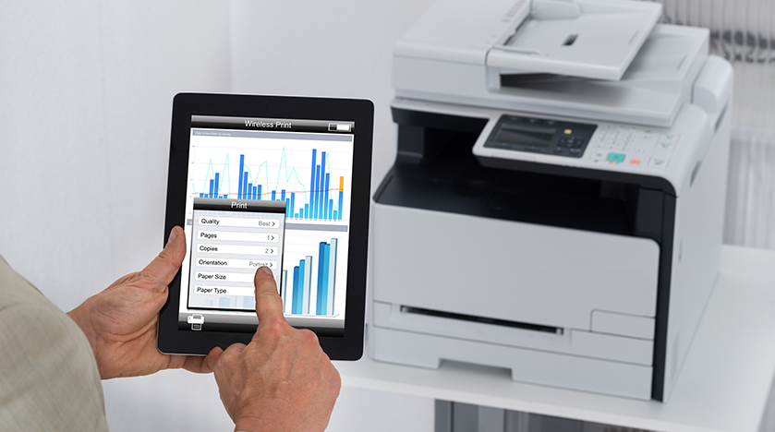
HOME WIRELESS DEVICES
Wireless Access Point
A wireless access point connects wireless devices to an Ethernet network, and to each other. It effectively does the same job as a hub/switch but for wireless devices. It only services a small area and therefore more suitable for home networks than large enterprise networks
Modem
This converts digital signals into analogue signals that are suitable for sending over a telephone line. More often than not the modem only serves one computer or few when inbuilt in a broadband therefore only suable for home networks.
Notes:
Wireless devices are mostly interchangeable in both home networks and enterprise networks
Some of the home wireless devices that are more fitting in home networks include;
Wireless Access Point
A wireless access point connects wireless devices to an Ethernet network, and to each other. It effectively does the same job as a hub/switch but for wireless devices. It only services a small area and therefore more suitable for home networks than large enterprise networks
Modem
This converts digital signals into analogue signals that are suitable for sending over a telephone line. More often than not the modem only serves one computer or few when inbuilt in a broadband therefore only suable for home networks.

Slide 8

ENTERPRISE WIRELESS DEVICES
Wi-Fi Range Extender/Repeater
Place in range of the existing Wireless network, and it will take the signal from the network and rebroadcast it, thus increasing the range of the network. It helps in extending the reach of the enterprise networks that have large office spaces. Therefore not particularly necessary for a home network.
Wide Area Network
An enterprise WAN is a corporate network that connects geographically dispersed users areas that could be anywhere in the world. This covers a very large area and unnecessarily expensive for a home network.
Notes:
Some of the home wireless devices that are more fitting in enterprise networks include;
Wide Area Network
An enterprise WAN is a corporate network that connects geographically dispersed users areas that could be anywhere in the world. This covers a very large area and unnecessarily expensive for a home network.

Slide 9
HOW WIRELESS NETWORKING WORKS
Radio waves are used in a wireless network just as they are used in televisions, mobile phones, and radios. Communication in a wireless network is very similar to two way radio communication.
It then sends the information through a wired Ethernet connection to the internet. This procedure also works backwards in which the router receives information from the internet and sends it to the computer.
Basically, first a computers wireless adapter changes the data into radio signals and then transmits these signals through the use of an antenna. Then a wireless router receives the signal and decodes it.
Notes:
Radio waves are used in a wireless network just as they are used in televisions, mobile phones, and radios. Communication in a wireless network is very similar to two way radio communication.
Basically, first a computers wireless adapter changes the data into radio signals and then transmits these signals through the use of an antenna. Then a wireless router receives the signal and decodes it.
It then sends the information through a wired Ethernet connection to the internet. This procedure also works backwards in which the router receives information from the internet and sends it to the computer.

Slide 10
The process of sending and receiving radio signals through wireless networks involves two devices, the transmitter and the receiver. The receiver picks up the waves with its antenna or aerial and turns the electric signal back into sound where it can be heard.
This form of modulation produces frequencies which are the ‘sum and the difference’ of the carrier and modulation frequencies. These frequencies are sometimes called sidebands.
To transmit sound by radio, the transmitter adds a high frequency carrier wave to the sound signal. This makes the amplitude of the carrier wave change, but the frequency stays the same. This is called Amplitude Modulation.
Notes:
The process of sending and receiving radio signals through wireless networks involves two devices, the transmitter and the receiver. The receiver picks up the waves with its antenna or aerial and turns the electric signal back into sound where it can be heard.
To transmit sound by radio, the transmitter adds a high frequency carrier wave to the sound signal. This makes the amplitude of the carrier wave change, but the frequency stays the same. This is called Amplitude Modulation.
This form of modulation produces frequencies which are the ‘sum and the difference’ of the carrier and modulation frequencies. These frequencies are sometimes called sidebands

Slide 11
WIRELESS NETWORKING STANDARDS
802.11 represents the IEEE designation for wireless networking. Several wireless networking specifications exist under the 802.11 banner.
IEEE 802.11: There were actually two variations on the initial 802.11 wireless standard. Both offered 1 or 2Mbps transmission speeds and the same RF of 2.4GHz. The difference between the two was in how data traveled through the RF media. One used FHSS, and the other used DSSS.
Notes:
802 is the current wireless networking standard. 802.11 represents the IEEE designation for wireless networking. Several wireless networking specifications exist under the 802.11 banner.
IEEE 802.11: There were actually two variations on the initial 802.11 wireless standard. Both offered 1 or 2Mbps transmission speeds and the same RF of 2.4GHz. The difference between the two was in how data traveled through the RF media. One used FHSS, and the other used DSSS.

Slide 12
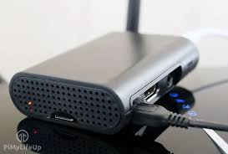
WIRELESS NETWORK STANDARDS
IEEE 802.11a: In terms of speed, the 802.11a standard was far ahead of the original 802.11 standards. 802.11a specified speeds of up to 54Mbps in the 5GHz band, but most commonly, communication takes place at 6Mbps, 12Mbps, or 24Mbps. 802.11a is incompatible with the 802.11b and 802.11g wireless standards.
Notes:
IEEE 802.11a: In terms of speed, the 802.11a standard was far ahead of the original 802.11 standards. 802.11a specified speeds of up to 54Mbps in the 5GHz band, but most commonly, communication takes place at 6Mbps, 12Mbps, or 24Mbps. 802.11a is incompatible with the 802.11b and 802.11g wireless standards

Slide 13
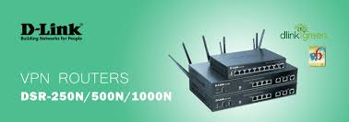
WIRELESS NETWORK STANDARDS
IEEE 802.11b: The 802.11b standard provides for a maximum transmission speed of 11Mbps. However, devices are designed to be backward-compatible with previous 802.11 standards that provided for speeds of 1, 2, and 5.5Mbps. 802.11b uses a 2.4GHz RF range and is compatible with 802.11g
Notes:
IEEE 802.11b: The 802.11b standard provides for a maximum transmission speed of 11Mbps. However, devices are designed to be backward-compatible with previous 802.11 standards that provided for speeds of 1, 2, and 5.5Mbps. 802.11b uses a 2.4GHz RF range and is compatible with 802.11g

Slide 14
IEEE 802.11n: The newest of the wireless standards listed in the Network+ objectives is 802.11n. The goal of the 802.11n standard is to significantly increase throughput in both the 2.4GHz and the 5GHz frequency range. The baseline goal of the standard was to reach speeds of 100Mbps, but given the right conditions, it is estimated that the 802.11n speeds might reach a staggering 600Mbps. In practical operation, 802.11n speeds will be much slower.
IEEE 802.11g: 802.11g is a popular wireless standard today. 802.11g offers wireless transmission over distances of 150 feet and speeds up to 54Mbps compared with the 11Mbps of the 802.11b standard. Like 802.11b, 802.11g operates in the 2.4GHz range and therefore is compatible with it.
Notes:
IEEE 802.11g: 802.11g is a popular wireless standard today. 802.11g offers wireless transmission over distances of 150 feet and speeds up to 54Mbps compared with the 11Mbps of the 802.11b standard. Like 802.11b, 802.11g operates in the 2.4GHz range and therefore is compatible with it.
IEEE 802.11n: The newest of the wireless standards listed in the Network+ objectives is 802.11n. The goal of the 802.11n standard is to significantly increase throughput in both the 2.4GHz and the 5GHz frequency range. The baseline goal of the standard was to reach speeds of 100Mbps, but given the right conditions, it is estimated that the 802.11n speeds might reach a staggering 600Mbps. In practical operation, 802.11n speeds will be much slower.

Slide 15
SECURITY CONSIDERATIONS AND POLICY
There are a number of main threats that exist to wireless LANS, these include:
Rogue Access Points/Ad-Hoc Networks
Denial of Service
Configuration Problems (Mis-Configurations/Incomplete Configurations)
Passive Capturing
Viruses and worms
When creating a security policy
Have a clear statement of purpose and scope
Provide a clear description of the approval process and the identity of those individual(s) with the authority to inspect and authorize a new access point.
Access point placement should maximize their performance capability but minimize eavesdropping and malicious activities.
State the types of systems that may be granted wireless access, the business requirements that justify the provision of wireless access and the appropriate approval procedure.
Notes:
Consideration that can be made in network security are threats that it faces. There are a number of main threats that exist to wireless LANS, these include:
Rogue Access Points/Ad-Hoc Networks
Denial of Service
Configuration Problems (Mis-Configurations/Incomplete Configurations)
Passive Capturing
Viruses and worms
When creating a security policy
Have a clear statement of purpose and scope
Provide a clear description of the approval process and the identity of those individual(s) with the authority to inspect and authorize a new access point.
Access point placement should maximize their performance capability but minimize eavesdropping and malicious activities.
State the types of systems that may be granted wireless access, the business requirements that justify the provision of wireless access and the appropriate approval procedure.

Slide 16
References
A. Harris, M., & P. Patten, K. (2014). Mobile device security considerations for small-and medium-sized enterprise business mobility. Information Management & Computer Security, 22(1), 97-114.
Choyi, V. K., & Vinokurov, D. (2012). U.S. Patent No. 8,191,106. Washington, DC: U.S. Patent and Trademark Office.
Garg, V. (2010). Wireless communications & networking. Elsevier.
Bernardos, C. J., De La Oliva, A., Serrano, P., Banchs, A., Contreras, L. M., Jin, H., & Zúñiga, J. C. (2014). An architecture for software defined wireless networking. IEEE Wireless Communications Magazine, 21(3), 52-61.

